Slide 1
International Conference in Artificial intelligence and cyber security in civil and military application
Larnaca cyprus, 30 may 2024
Flying into the Future: Technology Trends and Research at the Hellenic Air Force Academy
Ioanna K. Lekea (Director of the War Games Lab)
Assistant Professor
Hellenic Air Force Academy
Department of Aeronautical Sciences
Division of Leadership-Command, Humanities, and Physiology
ioanna.lekea@hafa.haf.gr

Slide 2
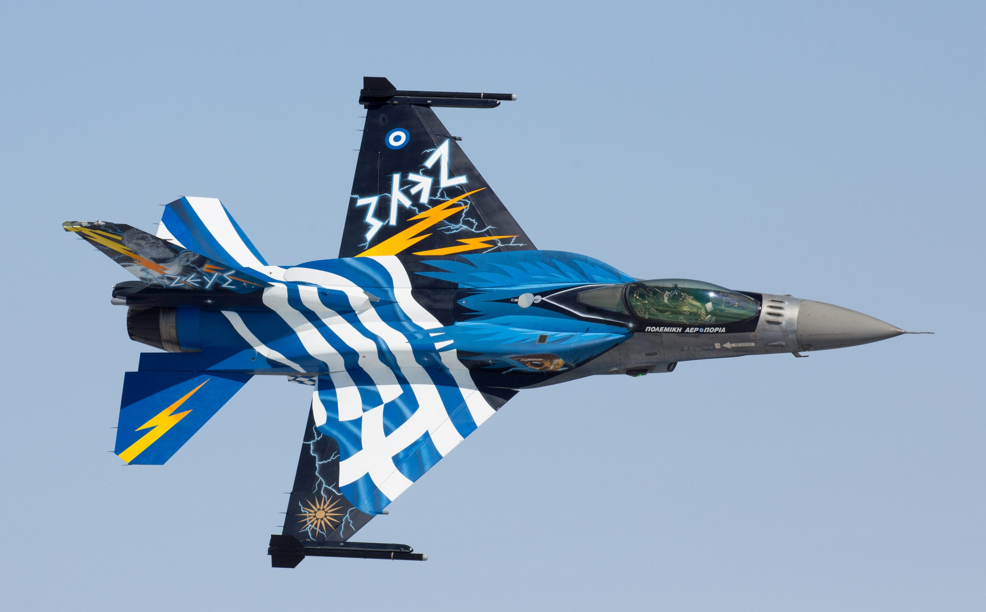
Content
Areas of research/interest
Introduction
Research projects

Slide 3
1931
HelleNIC AIR FORCE ACADEMY
Areas of interest
Flight Training
Diverse Mission Success
- We have been actively engaged in research within these fields since 2003, having numerous national and international collaborations.
- To date, we have produced over 50 publications, apps, and educational tools advancing knowledge and innovation in the field.
Flight safety

Slide 4
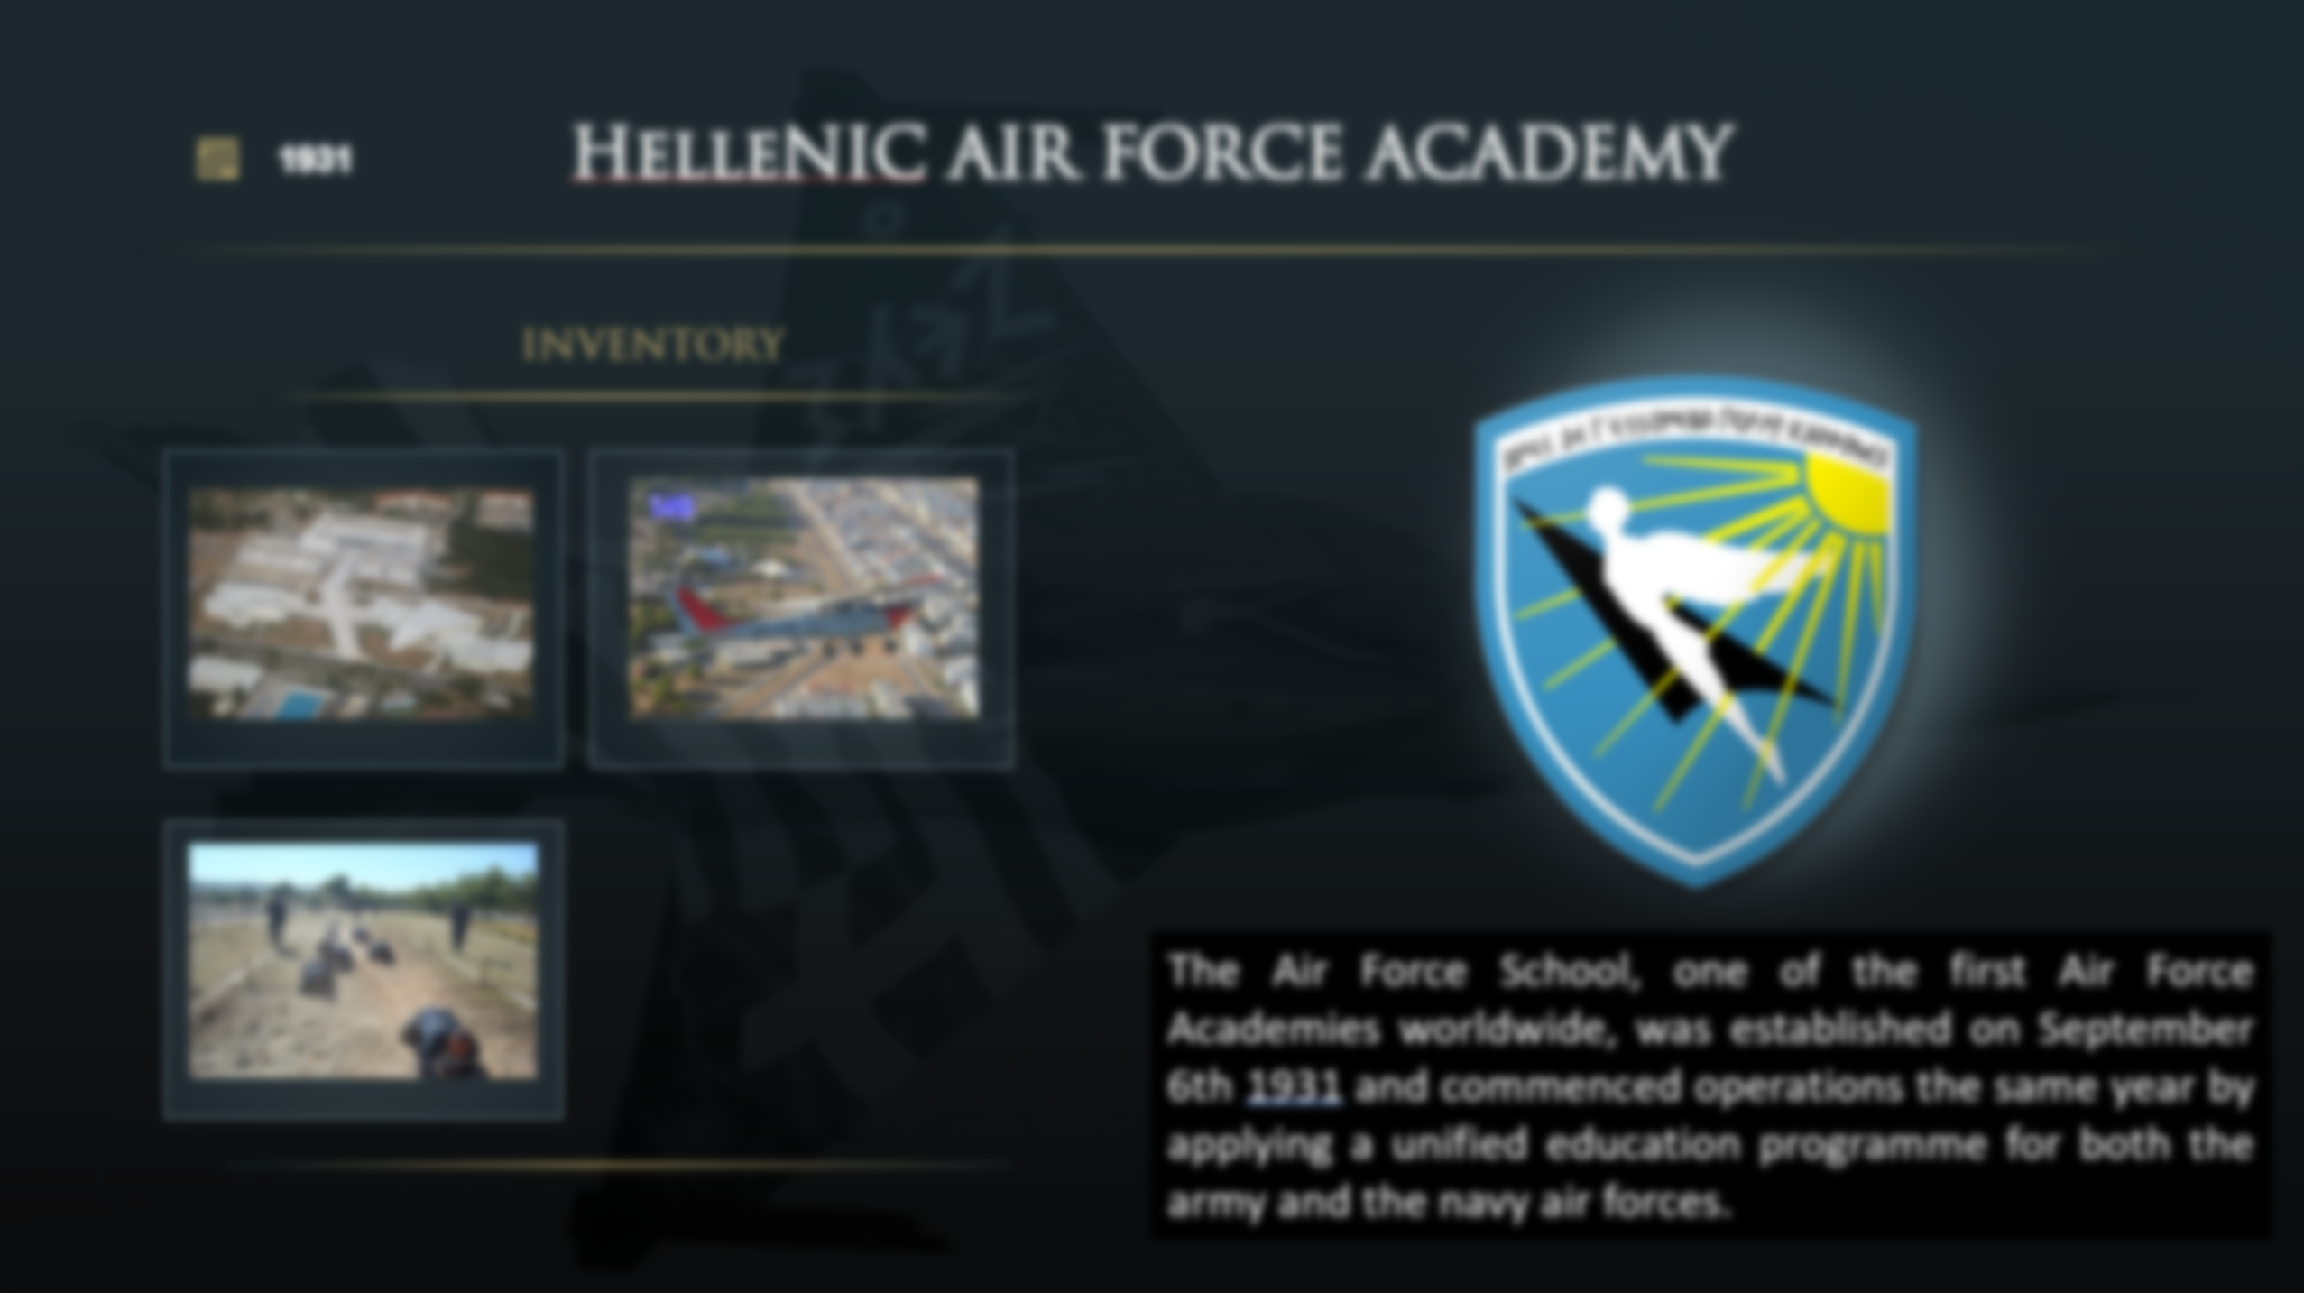
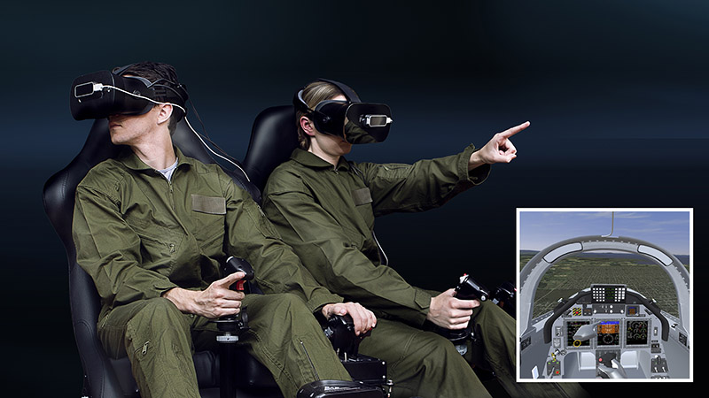
flight Training
Missions & Operations
Human Augmentation
Moral Enhancement
Using AR/VR and apps: procedures and emergencies during flight

Slide 5
flight Training
Missions & Operations
Cross-cutting
Human Augmentation
Moral Enhancement
Flight Safety: Using AI to prevent accidents, educate, detect risks, and enhance safety protocols in the air
Prevention training using games, smart devices, and apps in various areas related to flight safety
Using AR/VR and apps: procedures and emergencies during flight

Slide 6
Missions & Operations
Cross-cutting
Human Augmentation
Moral Enhancement
Flight Safety: Using AI to prevent accidents, educate, detect risks, and enhance safety protocols in the air
Prevention training using games, smart devices, and apps in various areas related to flight safety

Slide 7
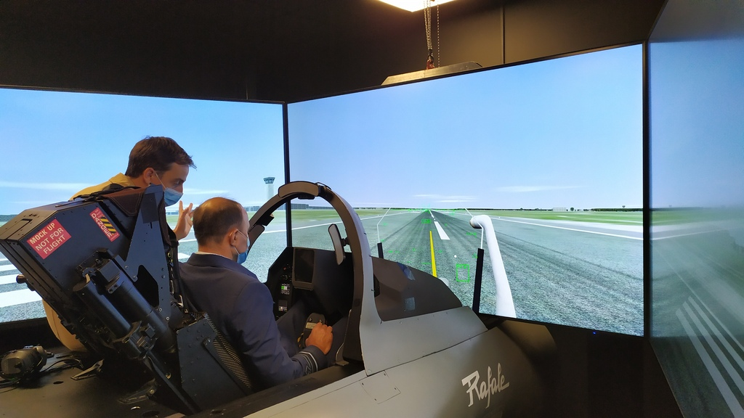
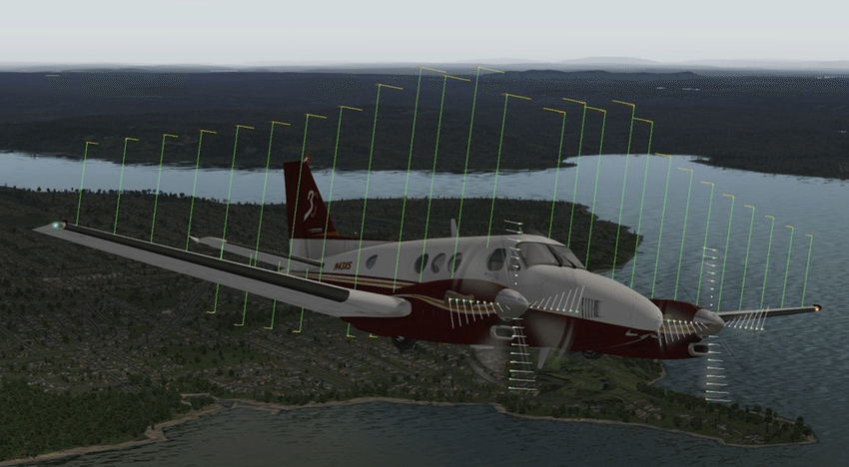
Flight training
Traditional Training
Providing theoretical knowledge in class (Aeronautics) & hands-on training
Flight Training: An Innovative Approach
Problem Basel Learning Approach

Slide 8
Traditional Training
Innovative APPROACH
Providing theoretical knowledge in class (Aeronautics) & hands-on training
Training Approach | Benefit | Limitation
Theoretical aeronautical background, documentaries, or educational film | By role-playing with a flight emergency | Cannot prepare pilots to deal with complex situations in limited time while being under stress
Discussion on safety regulations before or after a real or simulated flight | Discussion and analysis of applied issues takes place and theory is combined with practice | No access to specially developed educational materials that will help them understand the reason (Aeronautics) behind the actions
Use of tested scenarios with limited risk of the future pilots involved during real or simulated flight | Trainees feel emergency situations | Train pilots in dangerous situations to show them how to deal with mid-air crises instructor must be presented
Problem-Based Learning (PBL) approach
Selection of flight scenarios
Develop the Virtual Reality (VR) Simulator
Check with appropriate questionnaires to evaluate
the selected flight scenarios
the players’ satisfaction
the scenarios that Cadets seek to be examined
Benefits
Provide future pilots with well-rounded training
Test the level of trainees’ theoretical knowledge
Check how stress and time limitations affect pilots
Trainees get virtual hands-on training, and, the most complete possible education, in terms of theory and practice
Trainees can supplement their flight training whenever they feel like using the VR simulation on their personal computer (PC) or smartphone

Slide 9
Traditional Training
Innovative APPROACH
Providing theoretical knowledge in class (Aeronautics) & hands-on training
Training Approach | Benefit | Limitation
Theoretical aeronautical background, documentaries, or educational film | By role-playing with a flight emergency | Cannot prepare pilots to deal with complex situations in limited time while being under stress
Discussion on safety regulations before or after a real or simulated flight | Discussion and analysis of applied issues takes place and theory is combined with practice | No access to specially developed educational materials that will help them understand the reason (Aeronautics) behind the actions
Use of tested scenarios with limited risk of the future pilots involved during real or simulated flight | Trainees feel emergency situations | Train pilots in dangerous situations to show them how to deal with mid-air crises instructor must be presented
Problem-Based Learning (PBL) approach
Selection of flight scenarios
Develop the Virtual Reality (VR) Simulator
Check with appropriate questionnaires to evaluate
the selected flight scenarios
the players’ satisfaction
the scenarios that Cadets seek to be examined
Benefits
Provide future pilots with well-rounded training
Test the level of trainees’ theoretical knowledge
Check how stress and time limitations affect pilots
Trainees get virtual hands-on training, and, the most complete possible education, in terms of theory and practice
Trainees can supplement their flight training whenever they feel like using the VR simulation on their personal computer (PC) or smartphone

Slide 10
Mission & Operations
Human Augmentation
Enhance pilots‘ performance and effectiveness in tactical missions
Moral enhancement
Helping pilots dealing with ethical and legal dilemmas on the battlefield

Slide 11
Human augmentation
Moral enhancement
Human Augmentation for mission support via AI
Potential Uses
Ethical Decision Support: AI assists pilots in making decisions aligned with moral principles and IHL, ensuring actions are ethically and legally sound.
Goal Alignment: AI technology ensures that mission objectives are in harmony with ethical and legal guidelines, promoting responsible and morally upright conduct
Ethical Dilemma Resolution: AI systems help pilots navigate complex moral dilemmas by providing guidance and facilitating ethical discussions within the cockpit
Accountability and Transparency: AI algorithms promote accountability by transparently documenting decision-making processes, fostering trust and ethical responsibility among pilots
Ethical Training Integration: AI-enhanced training programs incorporate ethical scenarios and considerations, preparing pilots to handle moral challenges effectively during missions
Desired Outcomes
Doing the Right Thing: AI helps pilots make ethical decisions by guiding them toward actions that are morally and legally sound
Solving Tough Choices: AI assists pilots in resolving moral dilemmas by offering advice and facilitating ethical military decision-making
Being Responsible: AI promotes accountability by supporting decisions that align with ethical standards and legal obligations
Enhancing Morality at the Tactical Level: AI-based training helps pilots learn how to handle moral challenges so that they can make ethical decisions in real-world situations
Potential Uses
Adaptive Decision Support: AI systems can analyze vast amounts of data in real-time, providing pilots with timely and relevant information to make informed decisions during missions
Enhanced Situational Awareness: AI-powered sensors and algorithms can help pilots detect and track threats more accurately, improving their situational awareness in complex and dynamic environments
Predictive Analytics: By analyzing historical data and current inputs, AI can predict potential threats or mission outcomes, allowing pilots to proactively adjust their strategies for optimal performance
Cognitive Assistance: AI algorithms can assist pilots in managing cognitive loads by automating routine tasks, freeing up mental resources for higher-level decision-making and problem-solving
Personalized Training and Feedback: AI-based training systems can tailor instructional materials and simulations to individual pilots' strengths and weaknesses, accelerating skill acquisition and improving overall performance in tactical operations
Desired Outcomes
Smarter Decision-Making: AI helps pilots make better decisions by giving them helpful information right when they need it
Better Awareness: AI tools make it easier for pilots to see and understand what's happening around them during missions
Training Made Easy: AI training systems teach pilots better by adjusting to what they need to learn.

Slide 12
Human augmentation
Moral enhancement
Human Augmentation for mission support via AI
Potential Uses
Ethical Decision Support: AI assists pilots in making decisions aligned with moral principles and IHL, ensuring actions are ethically and legally sound.
Goal Alignment: AI technology ensures that mission objectives are in harmony with ethical and legal guidelines, promoting responsible and morally upright conduct
Ethical Dilemma Resolution: AI systems help pilots navigate complex moral dilemmas by providing guidance and facilitating ethical discussions within the cockpit
Accountability and Transparency: AI algorithms promote accountability by transparently documenting decision-making processes, fostering trust and ethical responsibility among pilots
Ethical Training Integration: AI-enhanced training programs incorporate ethical scenarios and considerations, preparing pilots to handle moral challenges effectively during missions
Desired Outcomes
Doing the Right Thing: AI helps pilots make ethical decisions by guiding them toward actions that are morally and legally sound
Solving Tough Choices: AI assists pilots in resolving moral dilemmas by offering advice and facilitating ethical military decision-making
Being Responsible: AI promotes accountability by supporting decisions that align with ethical standards and legal obligations
Enhancing Morality at the Tactical Level: AI-based training helps pilots learn how to handle moral challenges so that they can make ethical decisions in real-world situations
Potential Uses
Adaptive Decision Support: AI systems can analyze vast amounts of data in real-time, providing pilots with timely and relevant information to make informed decisions during missions
Enhanced Situational Awareness: AI-powered sensors and algorithms can help pilots detect and track threats more accurately, improving their situational awareness in complex and dynamic environments
Predictive Analytics: By analyzing historical data and current inputs, AI can predict potential threats or mission outcomes, allowing pilots to proactively adjust their strategies for optimal performance
Cognitive Assistance: AI algorithms can assist pilots in managing cognitive loads by automating routine tasks, freeing up mental resources for higher-level decision-making and problem-solving
Personalized Training and Feedback: AI-based training systems can tailor instructional materials and simulations to individual pilots' strengths and weaknesses, accelerating skill acquisition and improving overall performance in tactical operations
Desired Outcomes
Smarter Decision-Making: AI helps pilots make better decisions by giving them helpful information right when they need it
Better Awareness: AI tools make it easier for pilots to see and understand what's happening around them during missions
Training Made Easy: AI training systems teach pilots better by adjusting to what they need to learn.

Slide 13
Cross cutting
Ai & flight safety
Flight safety with a focus on ethics

Slide 14
Ai & flight safety
flight safety & ethics
Using AI to prevent accidents, educate, detect risks, and enhance safety protocols in the air
Potential Uses
Accident Prevention: AI analyses data to predict and prevent potential accidents before they occur
Education: AI-powered systems provide pilots and crew with real-time educational resources and guidance on safety procedures
Safety Protocol Enhancement: AI continuously monitors safety protocols based on real-time data and feedback from real-life cases
Desired Outcomes
Gamification: Using interactive games to train pilots and crew in various aspects of flight safety, supporting engaging and effective learning
Smart Devices: Utilizing wearable technology and smart devices to provide real-time feedback and training during simulations or actual flights
Mobile Apps: Offering accessible and convenient training materials and resources through mobile applications, allowing pilots to practice safety procedures anytime, anywhere
Areas of Interest
Explore and understand:
- Organizational Ethics & Safety Culture
Impact of Culture on Aviation Accidents
Impact of Organizational Ethics on the Occurrence & Prevention of Aviation Accidents
App & Digital Platform Development
Desired Outcomes
Early Detection: Using AI and purpose-built tools to early detect potential problems before they become serious safety issues
Training: Providing pilots and crew with thorough and ongoing training to handle various situations and emergencies
Prevention: Implementing measures and protocols to prevent accidents and ensure safe operations at all times

Slide 15
Ai & flight safety
flight safety & ethics
Using AI to prevent accidents, educate, detect risks, and enhance safety protocols in the air
Potential Uses
Accident Prevention: AI analyses data to predict and prevent potential accidents before they occur
Education: AI-powered systems provide pilots and crew with real-time educational resources and guidance on safety procedures
Safety Protocol Enhancement: AI continuously monitors safety protocols based on real-time data and feedback from real-life cases
Desired Outcomes
Gamification: Using interactive games to train pilots and crew in various aspects of flight safety, supporting engaging and effective learning
Smart Devices: Utilizing wearable technology and smart devices to provide real-time feedback and training during simulations or actual flights
Mobile Apps: Offering accessible and convenient training materials and resources through mobile applications, allowing pilots to practice safety procedures anytime, anywhere
Areas of Interest
Explore and understand:
- Organizational Ethics & Safety Culture
Impact of Culture on Aviation Accidents
Impact of Organizational Ethics on the Occurrence & Prevention of Aviation Accidents
App & Digital Platform Development
Desired Outcomes
Early Detection: Using AI and purpose-built tools to early detect potential problems before they become serious safety issues
Training: Providing pilots and crew with thorough and ongoing training to handle various situations and emergencies
Prevention: Implementing measures and protocols to prevent accidents and ensure safe operations at all times

Slide 16
Research projects
flight safety
Decision-making (DM) support tools

Slide 17
flight safety
DM support tools
AI-Based Ethical Decision Support Tool for Tactical Operations:
- Tactical Support: Provide real-time guidance in high-pressure situations with ethical considerations.
- Scenario Training: Offer immersive simulations for practicing decision-making in complex ethical dilemmas.
- Tailor recommendations using adaptive algorithms based on individual factors (experience, rank).
- Integration with existing command structures for efficient decision-making
Oversight & Feedback: Implement regular reviews to ensure accuracy and uphold ethical standards.
Development of a tool supporting holistic battlefield forensics
Safety Training Games: Develop interactive games for pilot and crew emergency training.
Wearable Safety Tech: Research AI-equipped wearables to monitor crew biometrics and fatigue.
App for Safety : Design a mobile app for personalized safety training and quizzes.
VR Emergency Training: Implement VR simulations for realistic emergency scenario training.
Ethical Decision Tool: Create an AI-based tool to aid in ethical flight decision-making.

Slide 18
flight safety
DM support tools
AI-Based Ethical Decision Support Tool for Tactical Operations:
- Tactical Support: Provide real-time guidance in high-pressure situations with ethical considerations.
- Scenario Training: Offer immersive simulations for practicing decision-making in complex ethical dilemmas.
- Tailor recommendations using adaptive algorithms based on individual factors (experience, rank).
- Integration with existing command structures for efficient decision-making
Oversight & Feedback: Implement regular reviews to ensure accuracy and uphold ethical standards.
Development of a tool supporting holistic battlefield forensics
Safety Training Games: Develop interactive games for pilot and crew emergency training.
Wearable Safety Tech: Research AI-equipped wearables to monitor crew biometrics and fatigue.
App for Safety : Design a mobile app for personalized safety training and quizzes.
VR Emergency Training: Implement VR simulations for realistic emergency scenario training.
Ethical Decision Tool: Create an AI-based tool to aid in ethical flight decision-making.

Slide 19
Thank you for your attention
questions

